Slide 1

Dar tu să continui în lucrurile pe care le-ai învăṭat ṣi de care ai fost convins! Ṣtii de la cine le-ai învăṭat ṣi cunoṣti Sfintele Scripturi încă din copilărie. Ele îṭi pot da înṭelepciunea care duce la mântuire prin credinṭa în Cristos Isus. Toată Scriptura este insuflată de Dumnezeu ṣi este de folos ca să înveṭe, să arate greṣelile, să îndrepte, să îndrume în dreptate pentru ca omul lui Dumnezeu să fie desăvârṣit ṣi întru totul echipat pentru orice faptă bună.

Slide 2
Tu tomēr paliec pie tā, ko esi mācījies un kas tev uzticēts, jo tu zini, no kā mācījies. Bet tu taču no bērnības zini Svētos Rakstus: tie spēj tevi pamācīt pestīšanai caur ticību uz Kristu Jēzu. Katrs Dieva iedvesmots raksts noderīgs mācīšanai, atspēkošanai, labošanai, audzināšanai taisnībā, Lai Dieva cilvēks būtu pilnīgs un katram labam darbam sagatavots.

Slide 3
Bada hi egon adi ikassi dituán eta eman içan çaizquián gaucetan, daquialaric norenganic ikassi vkan dituán: Eta nola haourra-danic letra sainduac eçagutu vkan dituán, ceinéc çuhur ahal baiheçaquete saluamendutacotz Iesus Christ baithan den fedeaz. Scriptura gucia duc diuinoqui inspiratua, eta probetchable doctrinatzeco, redarguitzeco, corregitzeco eta instruitzeco iustitiatan: Compli dadinçát Iaincoaren guiçona, obra on orotara complituqui instruituric.

Slide 4
Ṣugbọn iwọ duro ninu nkan wọnni ti iwọ ti kọ́, ti a si ti jẹ ki oju rẹ dá ṣáṣa si, ki iwọ ki o si mọ̀ ọdọ ẹniti iwọ gbé kọ́ wọn; Ati pe lati igba ọmọde ni iwọ ti mọ̀ iwe-mimọ́, ti o le sọ ọ di ọlọ́gbọn si igbala nipasẹ igbagbọ́ ninu Kristi Jesu. Gbogbo iwe-mimọ́ ti o ni imísi Ọlọrun li o si ni ère fun ẹkọ́, fun ibani-wi, fun itọ́ni, fun ikọ́ni ti o wà ninu ododo: Ki enia Ọlọrun ki o le pé, ti a ti mura silẹ patapata fun iṣẹ rere gbogbo.

Slide 5
Kepha wena yima kulokho okufundile nowaqiniseka kukho, wazi ukuthi ukufunde kobani, nokuthi kusukela ebuntwaneni wazi imibhalo engcwele enamandla okukuhlakaniphisa, kube yinsindiso ngokukholwa kuKristu Jesu. Yonke imibhalo iphefumulelwe nguNkulunkulu ilungele ukufundisa, nokusola, nokuqondisa, nokuyala ekulungeni, ukuze umuntu kaNkulunkulu aphelele, apheleliselwe yonke imisebenzi emihle.

Slide 6
σὺ δὲ μένε ἐν οἷς ἔμαθες καὶ ἐπιστώθης, εἰδὼς παρὰ τίνων ἔμαθες, καὶ ὅτι ἀπὸ βρέφους τὰ ἱερὰ γράμματα οἶδας, τὰ δυνάμενά σε σοφίσαι εἰς σωτηρίαν διὰ πίστεως τῆς ἐν Χριστῷ Ἰησοῦ. πᾶσα γραφὴ θεόπνευστος καὶ ὠφέλιμος πρὸς διδασκαλίαν, πρὸς ἐλεγμόν, πρὸς ἐπανόρθωσιν, πρὸς παιδείαν τὴν ἐν δικαιοσύνῃ, ἵνα ἄρτιος ᾖ ὁ τοῦ θεοῦ ἄνθρωπος, πρὸς πᾶν ἔργον ἀγαθὸν ἐξηρτισμένος.

Slide 7
Therefore go and make disciples of all nations, baptizing them in the name
of the Father and of the Son and of the Holy Spirit, and teaching them to obey everything I have commanded you.
Matthew 28:19-20

Slide 8
But as for you, continue in what you have learned and have become convinced of, because you know those from whom you learned it, and how from infancy you have known the holy Scriptures, which are able to make you wise for salvation through faith in Christ Jesus. All Scripture is God-breathed and is useful for teaching, rebuking, correcting and training in righteousness, so that the man of God may be thoroughly equipped for every good work.
2 Timothy 3:14-17

Slide 9
But as for you, continue in what you have learned and have become convinced of, because you know those from whom you learned it, and how from infancy you have known the holy Scriptures, which are able to make you wise for salvation through faith in Christ Jesus. All Scripture is God-breathed and is useful for teaching, rebuking, correcting and training in righteousness, so that the man of God may be thoroughly equipped for every good work.
2 Timothy 3:14-17

Slide 10
Genesis | Ecclesiastes
Exodus | Song of Songs
Leviticus | Isaiah
Numbers | Jeremiah
Deuteronomy | Lamentations
Joshua | Ezekiel
Judges | Daniel
Ruth | Hosea
1 Samuel | Joel
2 Samuel | Amos
1 Kings | Obadiah
2 Kings | Jonah
1 Chronicles | Micah
2 Chronicles | Nahum
Ezra | Habakkuk
Nehemiah | Zephaniah
Esther | Haggai
Job | Zechariah
Psalms | Malachi
Proverbs

Slide 11
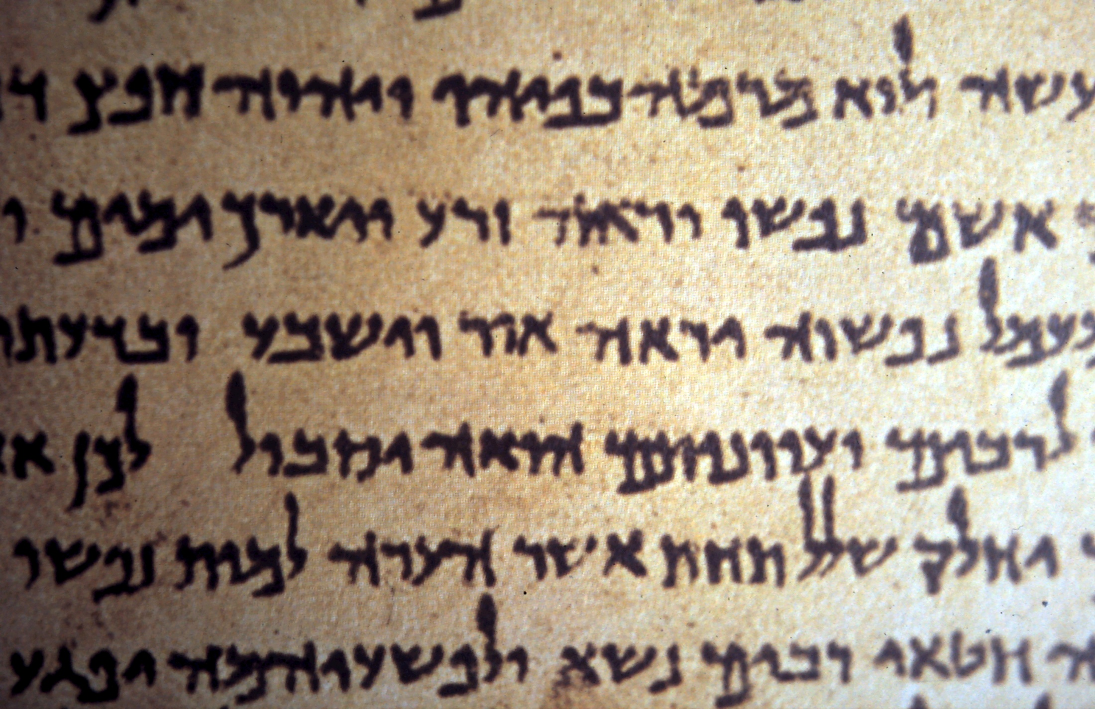

Slide 12
Bear in mind that our Lord's patience means salvation, just as our dear brother Paul also wrote to you with the wisdom that God gave him. He writes the same way in all his letters, speaking in them of these matters. His letters contain some things that are hard to understand, which ignorant and unstable people distort, as they do the other Scriptures, to their own destruction.
2 Peter 3:15-16

Slide 13
Matthew | 1 Timothy
Mark | 2 Timothy
Luke | Titus
John | Philemon
Acts | Hebrews
Romans | James
1 Corinthians | 1 Peter
2 Corinthians | 2 Peter
Galatians | 1 John
Ephesians | 2 John
Philippians | 3 John
Colossians | Jude
1 Thessalonians | Revelation
2 Thessalonians

Slide 15
But as for you, continue in what you have learned and have become convinced of, because you know those from whom you learned it, and how from infancy you have known the holy Scriptures, which are able to make you wise for salvation through faith in Christ Jesus. All Scripture is God-breathed and is useful for teaching, rebuking, correcting and training in righteousness, so that the man of God may be thoroughly equipped for every good work.
2 Timothy 3:14-17

Slide 16
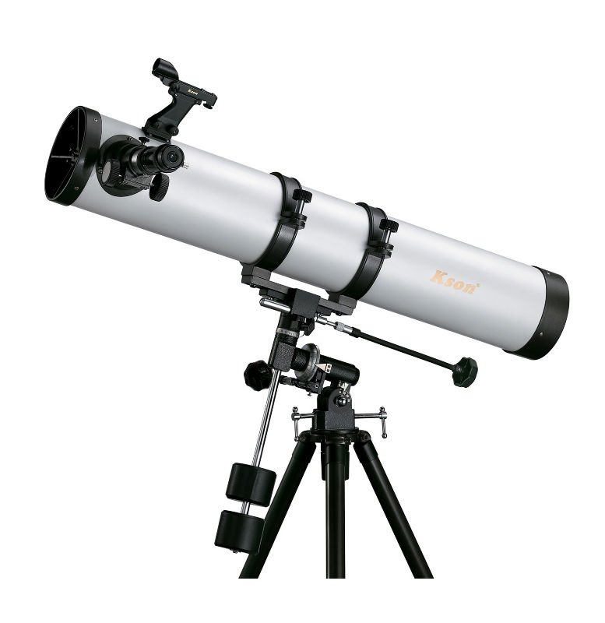
Genesis | Ecclesiastes
Exodus | Song of Songs
Leviticus | Isaiah
Numbers | Jeremiah
Deuteronomy | Lamentations
Joshua | Ezekiel
Judges | Daniel
Ruth | Hosea
1 Samuel | Joel
2 Samuel | Amos
1 Kings | Obadiah
2 Kings | Jonah
1 Chronicles | Micah
2 Chronicles | Nahum
Ezra | Habakkuk
Nehemiah | Zephaniah
Esther | Haggai
Job | Zechariah
Psalms | Malachi
Proverbs
Matthew | 1 Timothy
Mark | 2 Timothy
Luke | Titus
John | Philemon
Acts | Hebrews
Romans | James
1 Corinthians | 1 Peter
2 Corinthians | 2 Peter
Galatians | 1 John
Ephesians | 2 John
Philippians | 3 John
Colossians | Jude
1 Thessalonians | Revelation
2 Thessalonians

Slide 17
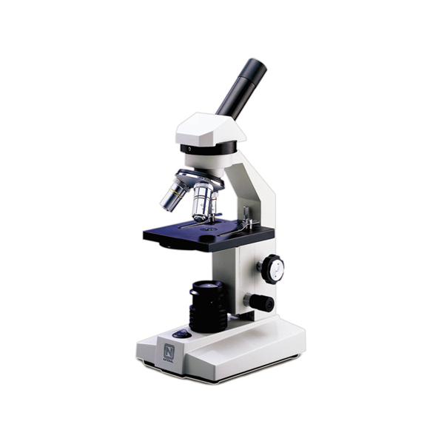
Genesis | Ecclesiastes
Exodus | Song of Songs
Leviticus | Isaiah
Numbers | Jeremiah
Deuteronomy | Lamentations
Joshua | Ezekiel
Judges | Daniel
Ruth | Hosea
1 Samuel | Joel
2 Samuel | Amos
1 Kings | Obadiah
2 Kings | Jonah
1 Chronicles | Micah
2 Chronicles | Nahum
Ezra | Habakkuk
Nehemiah | Zephaniah
Esther | Haggai
Job | Zechariah
Psalms | Malachi
Proverbs
Matthew | 1 Timothy
Mark | 2 Timothy
Luke | Titus
John | Philemon
Acts | Hebrews
Romans | James
1 Corinthians | 1 Peter
2 Corinthians | 2 Peter
Galatians | 1 John
Ephesians | 2 John
Philippians | 3 John
Colossians | Jude
1 Thessalonians | Revelation
2 Thessalonians

Slide 18
I tell you the truth, until heaven and earth disappear, not the smallest letter, not the least stroke of a pen, will by any means disappear from the Law until everything is accomplished.
Matthew 5:18

Slide 19
I tell you the truth, until heaven and earth disappear, not the smallest letter, י not the least stroke of a pen, will by any means disappear from the Law until everything is accomplished.
Matthew 5:18

Slide 20
זרעך zereka your seed
זרעיך zereyka your seeds
Cf. Galatians 3:16

Slide 21
I tell you the truth, until heaven and earth disappear, not the smallest letter, not the least stroke of a pen, ב כ will by any means disappear from the Law until everything is accomplished.
Matthew 5:18
b / k

Slide 22
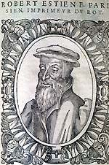
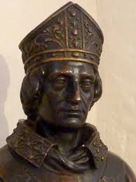
Stephen Langton,
Archbishop of Canterbury,
1207 - 1228
Robert Estienne,
1503 - 1559

Slide 23
The Revelation of the all-glorious evangelist, bosom friend of Jesus, beloved to Christ, John the theologian, son of Salome and Zebedee, but adopted son of Mary, the mother of God.
Title of Revelation in a Manuscript from Mt. Athos, Greece

Slide 24
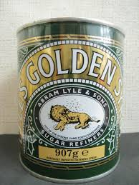
OUT OF THE STRONG CAME FORTH SWEETNESS
Judges 14:14b

Slide 25

FIAT LUX
Let there be light
Genesis 1:3a

Slide 26
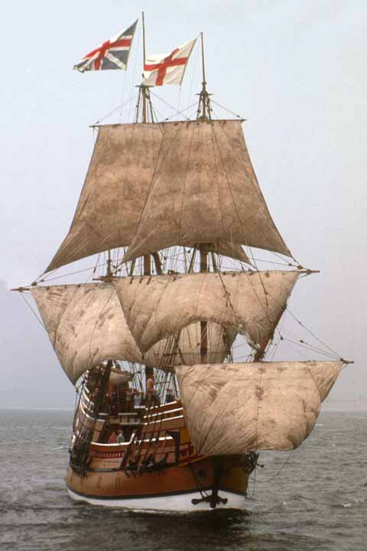
I charge you before God…that you follow me no further than you have seen me follow the Lord Jesus Christ. If God reveals anything to you by any other instrument of His, be as ready to receive it as you were to receive any truth by my ministry, for I am verily persuaded the Lord hath more truth yet to break forth out of His Holy Word.
John Robinson, 1620, addressing the Pilgrim Fathers leaving England for America

Slide 27
Catholics
Orthodox
Protestants
Jews
The Early Church Fathers
???
Talmud, Mishnah
All scripture

Slide 28
Catholics
Orthodox
Protestants
Jews
All scripture

Slide 29
But as for you, continue in what you have learned and have become convinced of, because you know those from whom you learned it, and how from infancy you have known the holy Scriptures, which are able to make you wise for salvation through faith in Christ Jesus. All Scripture is God-breathed and is useful for teaching, rebuking, correcting and training in righteousness, so that the man of God may be thoroughly equipped for every good work.
2 Timothy 3:14-17

Slide 30
But as for you, continue in what you have learned and have become convinced of, because you know those from whom you learned it, and how from infancy you have known the holy Scriptures, which are able to make you wise for salvation through faith in Christ Jesus. All Scripture is God-breathed and is useful for teaching, rebuking, correcting and training in righteousness, so that the man of God may be thoroughly equipped for every good work.
2 Timothy 3:14-17

Slide 31
But as for you, continue in what you have learned and have become convinced of, because you know those from whom you learned it, and how from infancy you have known the holy Scriptures, which are able to make you wise for salvation through faith in Christ Jesus. All Scripture is God-breathed and is useful for teaching, rebuking, correcting and training in righteousness, so that the man of God may be thoroughly equipped for every good work.
2 Timothy 3:14-17

Slide 32
Woe to those who go down to Egypt for help, who rely on horses, who trust in the multitude of their chariots and in the great strength of their horsemen,
Isaiah 31:1a

Slide 33
But as for you, continue in what you have learned and have become convinced of, because you know those from whom you learned it, and how from infancy you have known the holy Scriptures, which are able to make you wise for salvation through faith in Christ Jesus. All Scripture is God-breathed and is useful for teaching, rebuking, correcting and training in righteousness, so that the man of God may be thoroughly equipped for every good work.
2 Timothy 3:14-17

Slide 34
but do not look to the Holy One of Israel, or seek help from the Lord.
Isaiah 31:1b

Slide 35
But as for you, continue in what you have learned and have become convinced of, because you know those from whom you learned it, and how from infancy you have known the holy Scriptures, which are able to make you wise for salvation through faith in Christ Jesus. All Scripture is God-breathed and is useful for teaching, rebuking, correcting and training in righteousness, so that the man of God may be thoroughly equipped for every good work.
2 Timothy 3:14-17

Slide 36
But as for you, continue in what you have learned and have become convinced of, because you know those from whom you learned it, and how from infancy you have known the holy Scriptures, which are able to make you wise for salvation through faith in Christ Jesus. All Scripture is God-breathed and is useful for teaching, rebuking, correcting and training in righteousness, so that the man of God may be thoroughly equipped for every good work.
2 Timothy 3:14-17

